Slide 1
Generative Models Discriminative vs Generative
Understanding Machine Learning

Slide 2
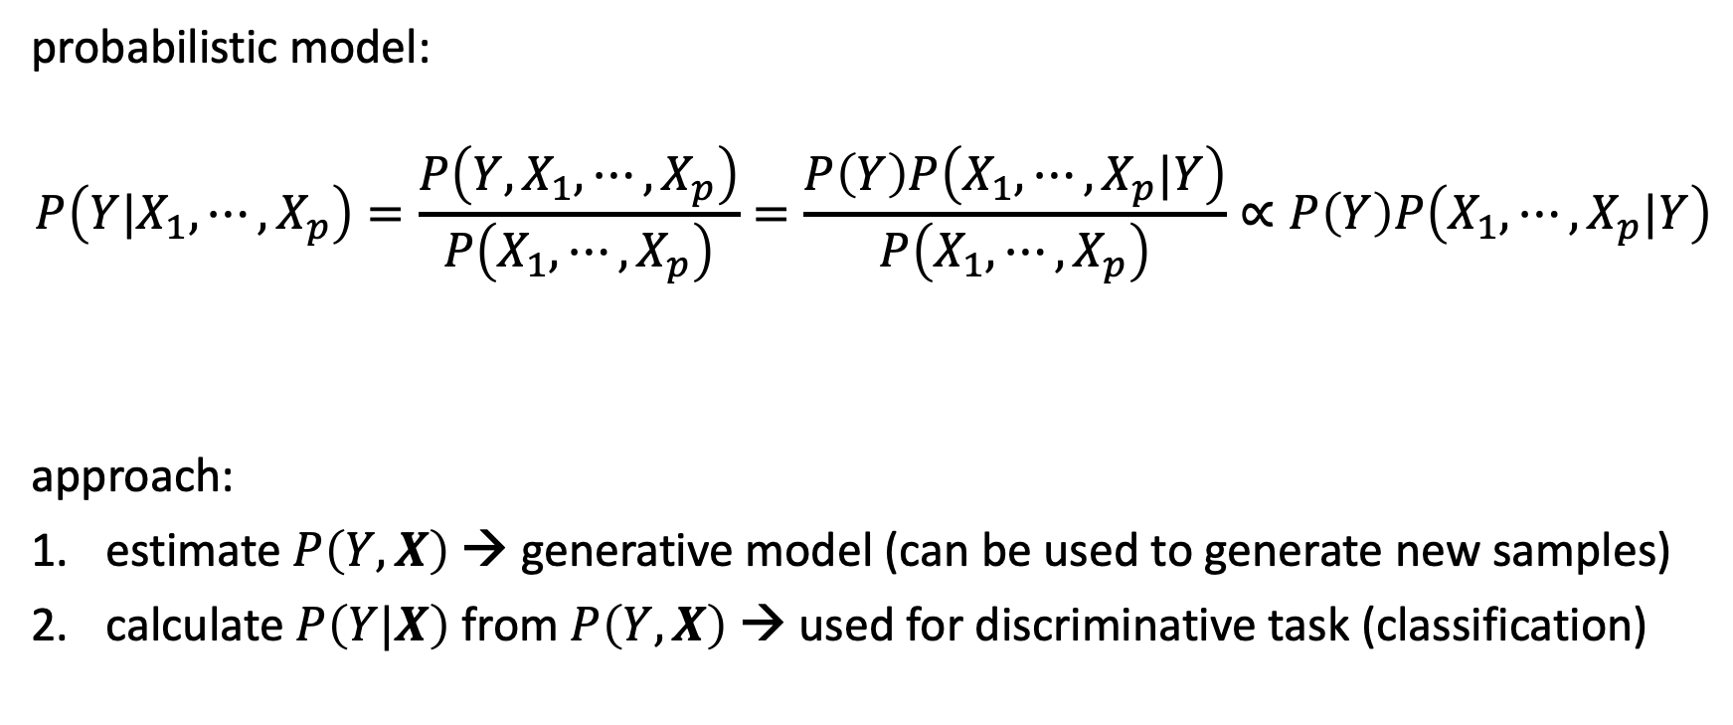
Archetype: Naïve Bayes
probabilistic model:
$$P\left(Y|X_{1}, ⋯,X_{p}\right)=\frac{P\left({Y,X}_{1}, ⋯,X_{p}\right)}{P\left(X_{1}, ⋯,X_{p}\right)}=\frac{P\left(Y\right)P\left(X_{1}, ⋯,X_{p}|Y\right)}{P\left(X_{1}, ⋯,X_{p}\right)}∝P\left(Y\right)P\left(X_{1}, ⋯,X_{p}|Y\right)$$
approach:
estimate $P\left(Y,X\right)$ → generative model (can be used to generate new samples)
calculate $P\left(Y|X\right)$ from $P\left(Y,X\right)$ → used for discriminative task (classification)
Bayes’ rule
constant
to be estimated

Slide 3

Independence Assumption
(naïve) assumption: conditional independence of features given target
$$P\left(X_{j}|Y,X_{1},{⋯,X}_{j−1},X_{j+1},⋯,X_{p}\right)=P\left(X_{j}|Y\right)$$
$$⟹P\left(Y|X_{1}, ⋯,X_{p}\right)=\frac{P\left(Y\right)\prod_{j=1}^{p}{P\left(X_{j}|Y\right)}}{P\left(X_{1},⋯,X_{p}\right)}$$
→ independent feature contributions (ignoring feature correlations)
→ robust against curse of dimensionality

Slide 4

Estimation of Feature Contributions
separate estimations of $P\left(X_{j}|Y\right)$ for each feature
requires assumption of distributions (e.g., Gaussian naïve Bayes) or non-parametric methods (kernel density estimation)
$P\left(x_{ij}|y\right)=\frac{1}{\sqrt{2πσ_{y,j}^{2}}}\exp\left(−\frac{{\left(x_{ij}−μ_{y,j}\right)}^{2}}{2σ_{y,j}^{2}}\right)$
parameter estimation (e.g., mean and variance of Gaussians) can be done with maximum likelihood method ($y$ known in training)
→ no Bayesian methods needed
Gaussian feature likelihoods:

Slide 5
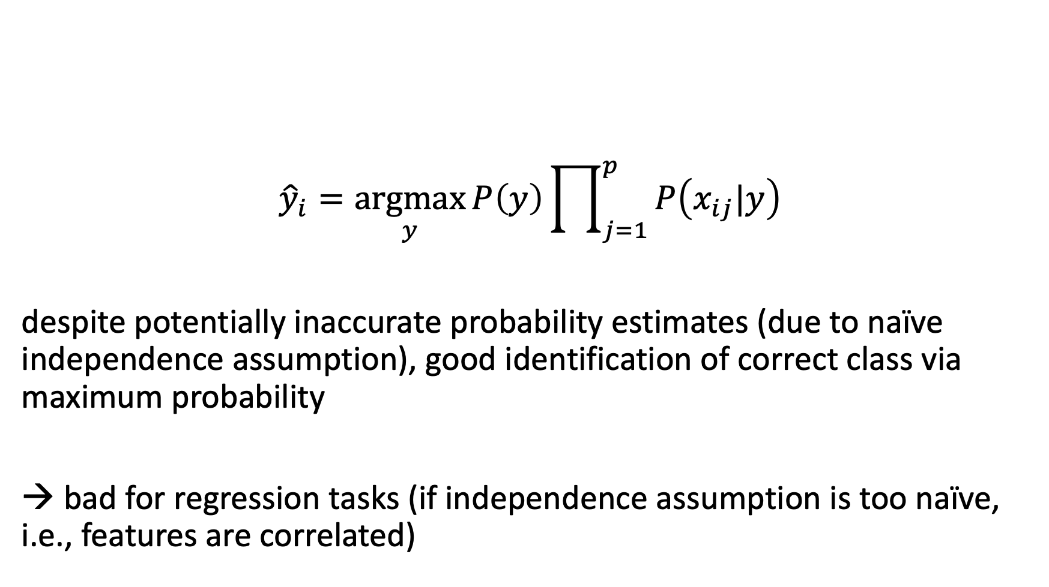
Maximum a Posteriori Classification
$${\hat{y}}_{i}=\underset{y}{argmax}{P\left(y\right)\prod_{j=1}^{p}{P\left(x_{ij}|y\right)}}$$
despite potentially inaccurate probability estimates (due to naïve independence assumption), good identification of correct class via maximum probability
→ bad for regression tasks (if independence assumption is too naïve, i.e., features are correlated)

Slide 6

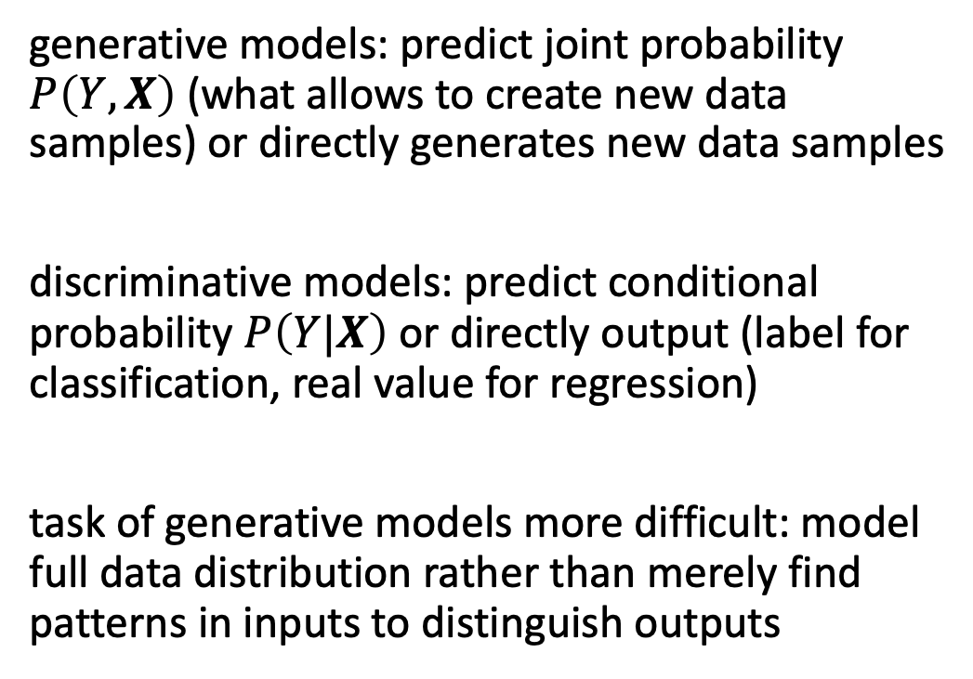
Generative vs Discriminative Models
generative models: predict joint probability $P\left(Y,X\right)$ (what allows to create new data samples) or directly generates new data samples
discriminative models: predict conditional probability $P\left(Y|X\right)$ or directly output (label for classification, real value for regression)
task of generative models more difficult: model full data distribution rather than merely find patterns in inputs to distinguish outputs
discriminative model
generative model
source

Slide 7
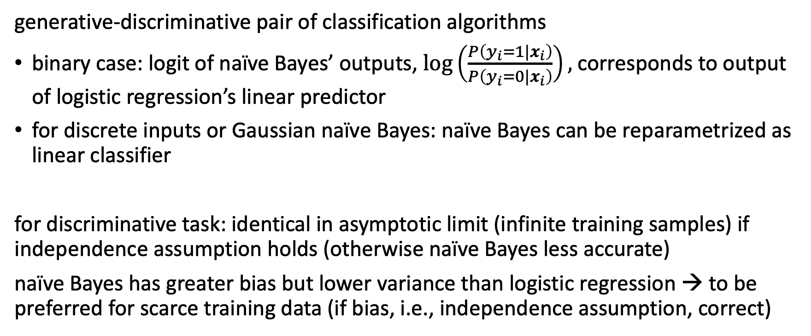
Naïve Bayes and Logistic Regression
generative-discriminative pair of classification algorithms
binary case: logit of naïve Bayes’ outputs, $\log\left(\frac{P\left(y_{i}=1|x_{i}\right)}{P\left(y_{i}=0|x_{i}\right)}\right),$ corresponds to output of logistic regression’s linear predictor
for discrete inputs or Gaussian naïve Bayes: naïve Bayes can be reparametrized as linear classifier
for discriminative task: identical in asymptotic limit (infinite training samples) if independence assumption holds (otherwise naïve Bayes less accurate)
naïve Bayes has greater bias but lower variance than logistic regression → to be preferred for scarce training data (if bias, i.e., independence assumption, correct)

Slide 8
Data Generation
generative models can be used for discriminative tasks (although potentially inferior to direct discriminative methods)
but generative methods do more than discriminative ones: model full data distribution
→ allows generation of new data samples (can be images, text, video, audio, code like SQL or Python, proteins, materials, time series, structured data, …)
large (auto-regressive) language models examples of generative models

Slide 9

Different Types of Generative Models
source

Slide 10
Variational Autoencoders (VAE)

Slide 11

Recap: Autoencoder
(deep) encoder network
(deep) decoder network
learned together by minimizing differences between original input and reconstructed input (expressed as losses)
compressed intermediate representation: dimensionality reduction
source

Slide 12

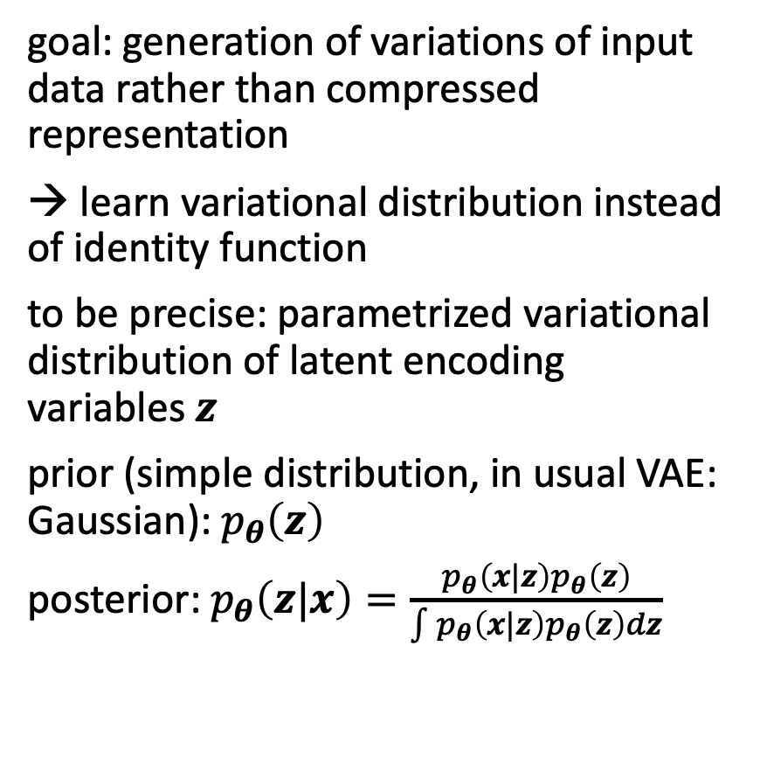
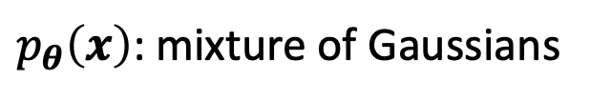
Autoencoder Architecture for Generative Tasks
goal: generation of variations of input data rather than compressed representation
→ learn variational distribution instead of identity function
to be precise: parametrized variational distribution of latent encoding variables $z$
prior (simple distribution, in usual VAE: Gaussian): $p_{θ}\left(z\right)$
posterior: $p_{θ}\left(z|x\right)=\frac{p_{θ}\left(x|z\right)p_{θ}\left(z\right)}{\int{p_{θ}\left(x|z\right)p_{θ}\left(z\right)}dz}$
from which to sample
from wikipedia
Variational Bayesian Method
$p_{θ}\left(x\right)$: mixture of Gaussians

Slide 13

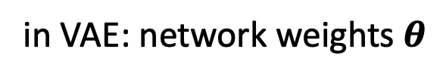

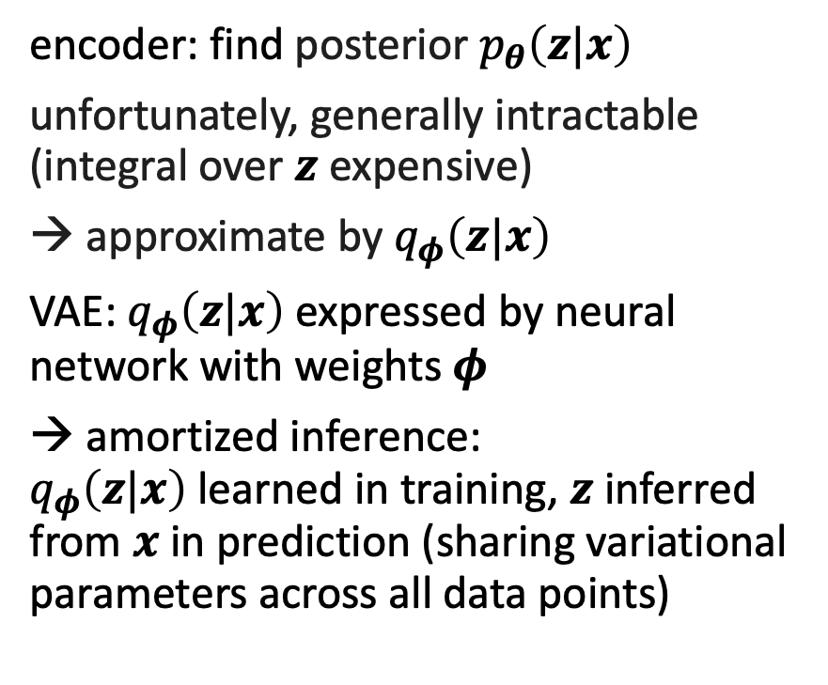
Encoder and Decoder Networks
encoder: find posterior $p_{θ}\left(z|x\right)$
unfortunately, generally intractable (integral over $z$ expensive)
→ approximate by $q_{φ}\left(z|x\right)$
VAE: $q_{φ}\left(z|x\right)$ expressed by neural network with weights $φ$
→ amortized inference: $q_{φ}\left(z|x\right)$learned in training, $z$ inferred from $x$ in prediction (sharing variational parameters across all data points)
decoder: generate new sample $x_{i}$
sample $z_{i}$ (from Gaussian)
generate $x_{i}$ (similar to real data)
→ maximize: $p_{θ}\left(x_{i}\right)=\int{p_{θ}\left(x_{i}|z\right)}p_{θ}\left(z\right)dz$
(expensive → use only likely codes $z$ given input $x$: need for encoder)
encoder network
decoder network
in VAE: network weights $θ$
source

Slide 14
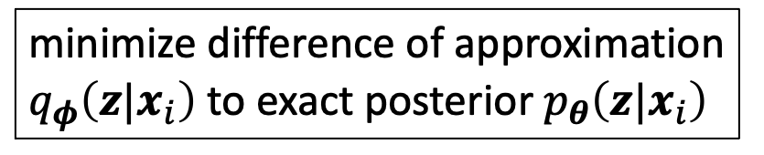
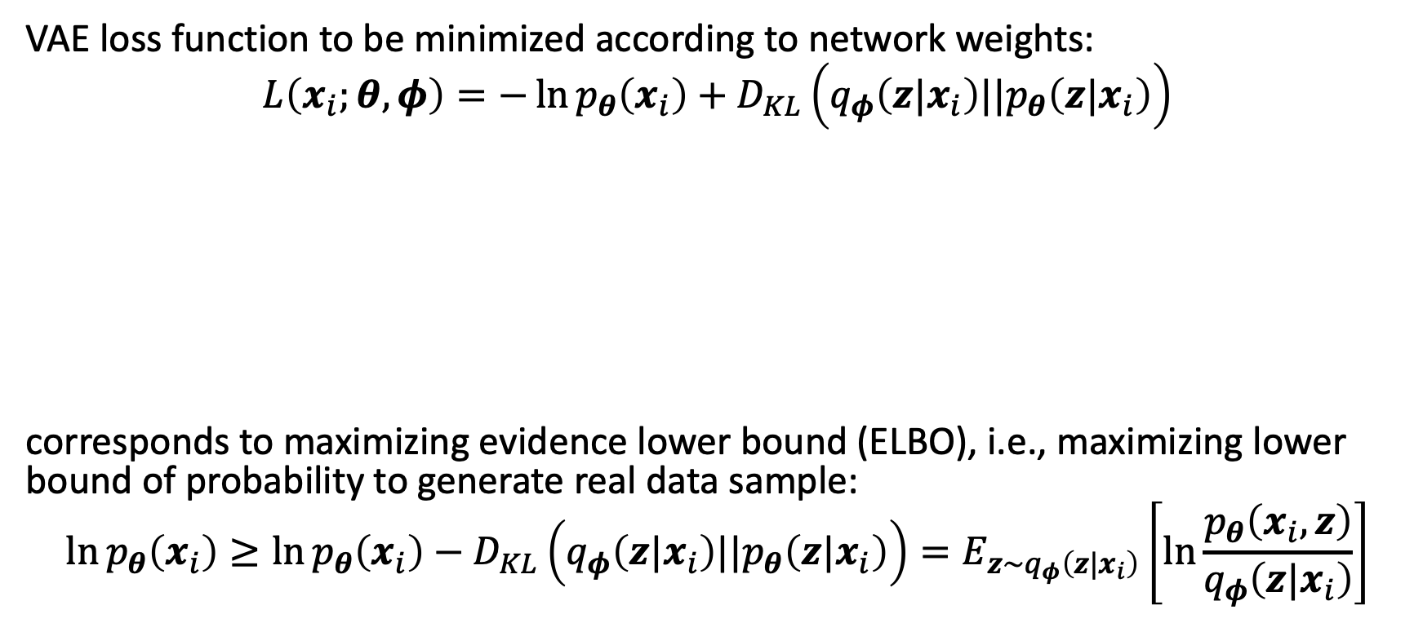
VAE Loss: ELBO
VAE loss function to be minimized according to network weights:
$$L\left(x_{i};θ,φ\right)=−\ln{p_{θ}\left(x_{i}\right)+D_{KL}\left(q_{φ}\left(z|x_{i}\right)||p_{θ}\left(z|x_{i}\right)\right)}$$
corresponds to maximizing evidence lower bound (ELBO), i.e., maximizing lower bound of probability to generate real data sample:
$$\ln{p_{θ}\left(x_{i}\right)}≥\ln{p_{θ}\left(x_{i}\right)−D_{KL}\left(q_{φ}\left(z|x_{i}\right)||p_{θ}\left(z|x_{i}\right)\right)}=E_{z\sim q_{φ}\left(z|x_{i}\right)}\left[\ln{\frac{p_{θ}\left(x_{i},z\right)}{q_{φ}\left(z|x_{i}\right)}}\right]$$
maximize likelihood of observed data (minimize reconstruction error)
minimize difference of approximation $q_{φ}\left(z|x_{i}\right)$ to exact posterior $p_{θ}\left(z|x_{i}\right)$
and
can be interpreted as regularizer
non-negative

Slide 15

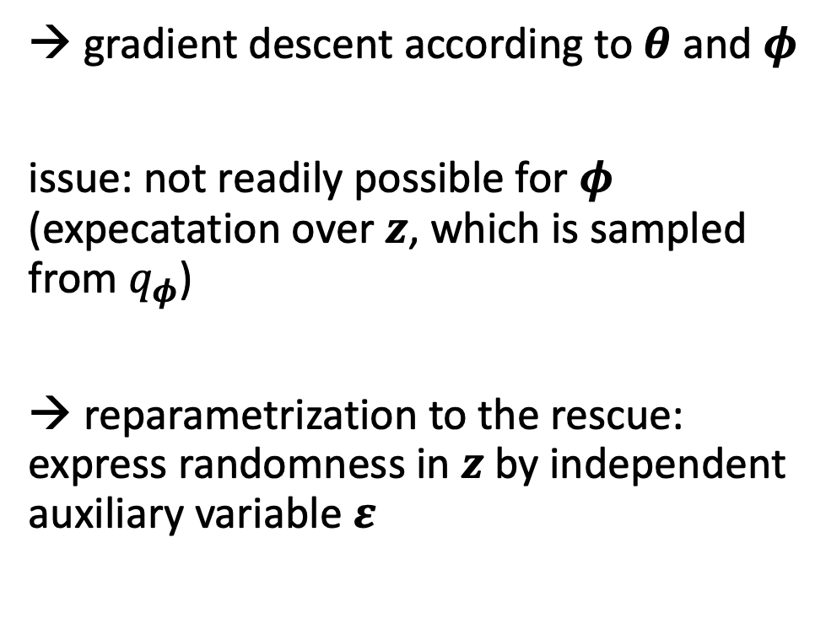
Reparameterization Trick
→ gradient descent according to $θ$ and $φ$
issue: not readily possible for $φ$ (expecatation over $z$, which is sampled from $q_{φ}$)
→ reparametrization to the rescue: express randomness in $z$ by independent auxiliary variable $ε$
from wikipedia

Slide 16

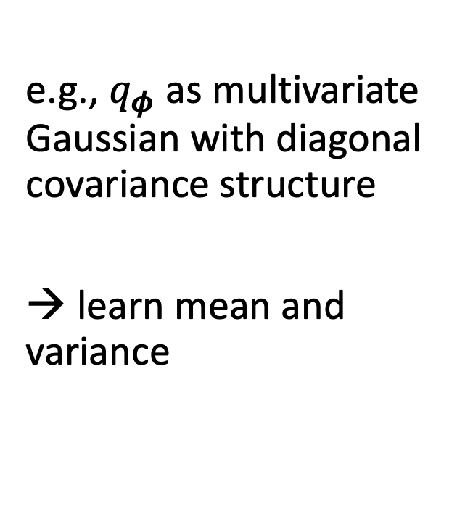
e.g., $q_{φ}$ as multivariate Gaussian with diagonal covariance structure
→ learn mean and variance
from wikipedia

Slide 17
Flow-Based Methods

Slide 18

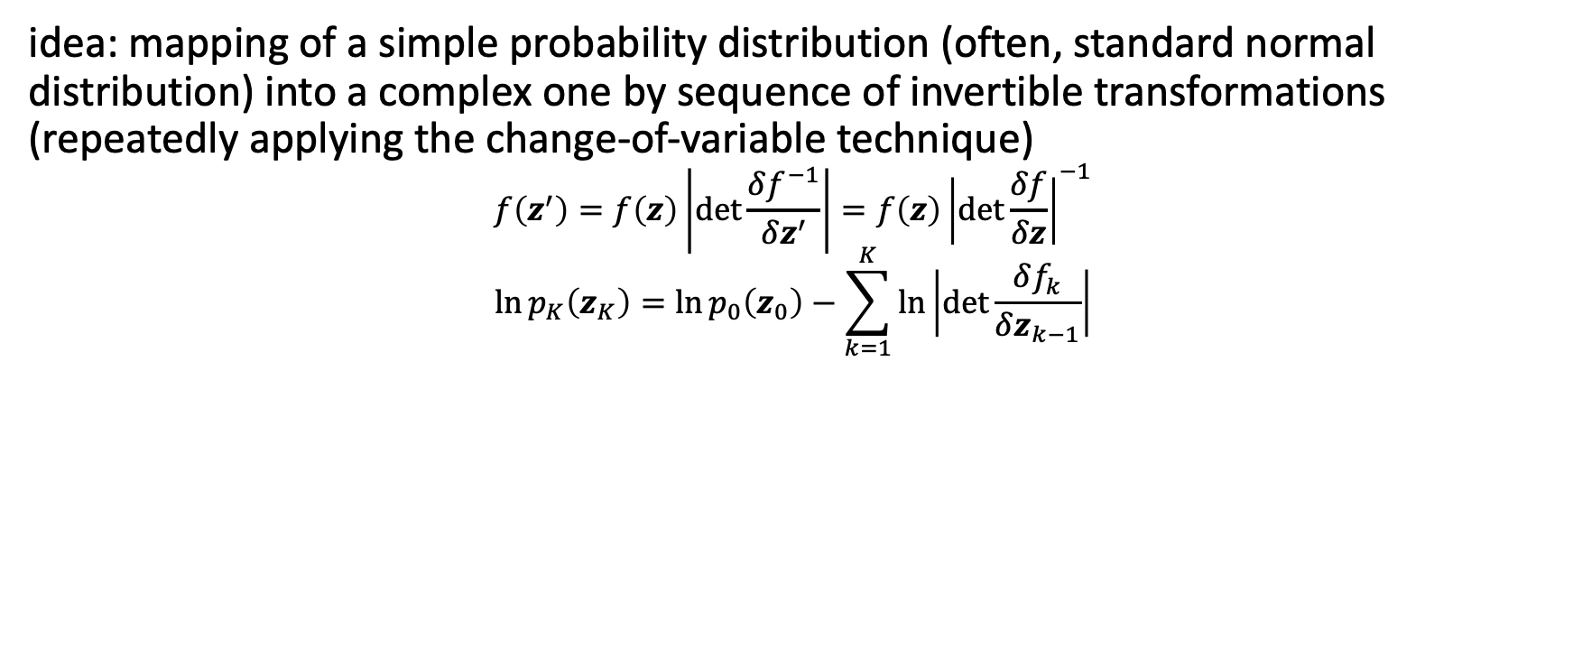

Normalizing Flows
idea: mapping of a simple probability distribution (often, standard normal distribution) into a complex one by sequence of invertible transformations (repeatedly applying the change-of-variable technique)
$$f\left(z^{′}\right)=f\left(z\right)\left|\det{\frac{δf^{−1}}{δz^{′}}}\right|=f\left(z\right){\left|det\frac{δf}{δz}\right|}^{−1}$$
$$\ln{p_{K}\left(z_{K}\right)}=\ln{p_{0}\left(z_{0}\right)}−\sum_{k=1}^{K}{\ln\left|\det{\frac{δf_{k}}{δz_{k−1}}}\right|}$$
log-likelihood:
flow
normalizing flow
$$⋯$$
source

Slide 19
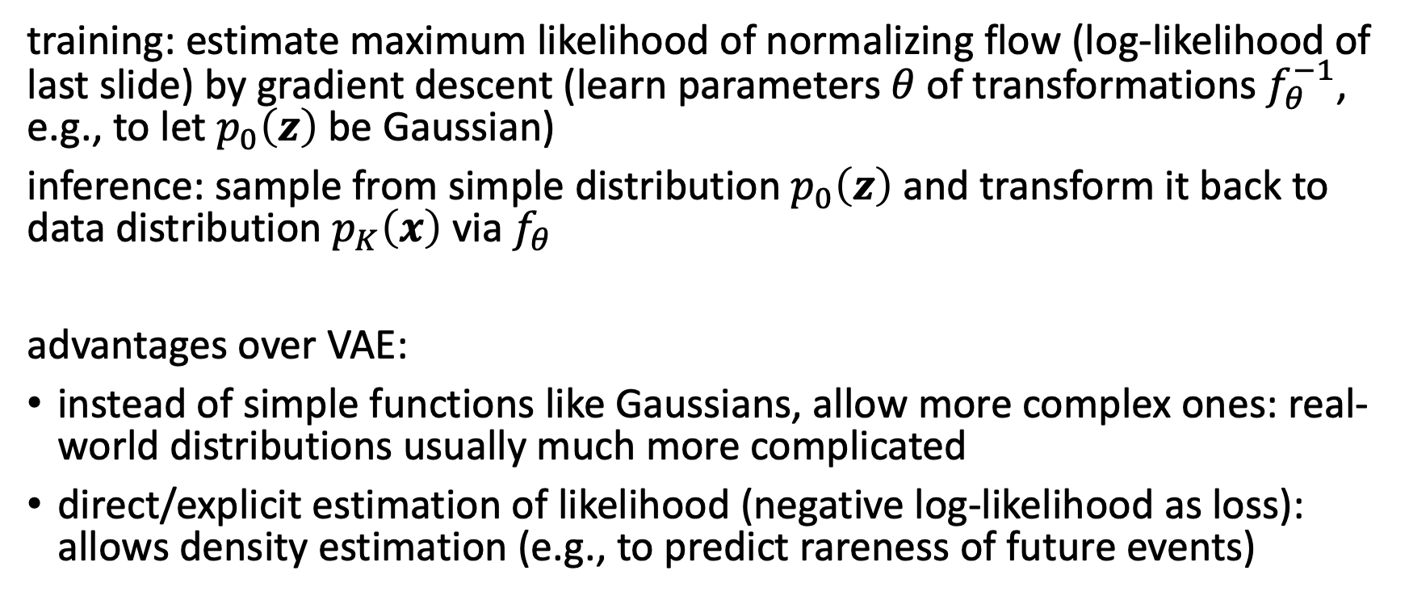
Usage in Generative Models
training: estimate maximum likelihood of normalizing flow (log-likelihood of last slide) by gradient descent (learn parameters $θ$ of transformations $f_{θ}^{−1}$, e.g., to let $p_{0}\left(z\right)$be Gaussian)
inference: sample from simple distribution $p_{0}\left(z\right)$and transform it back to data distribution $p_{K}\left(x\right)$ via $f_{θ}$
advantages over VAE:
instead of simple functions like Gaussians, allow more complex ones: real-world distributions usually much more complicated
direct/explicit estimation of likelihood (negative log-likelihood as loss): allows density estimation (e.g., to predict rareness of future events)

Slide 20
Invertible Neural Networks
neural networks representing invertible/bijective functions can be used for normalizing flow transformations
need for specialized architectures to construct reversible transform (e.g., affine coupling layers)

Slide 21
Generative Adversarial Networks (GAN)

Slide 22
Indirect Training via Discriminator
two neural networks playing a zero-sum game:
the generator network G generating new (fake) samples
the discriminator network D trying to distinguish between real and fake samples
idea: G not trained directly to minimize reconstruction error of real samples, but to fool D → self-supervised approach

Slide 23

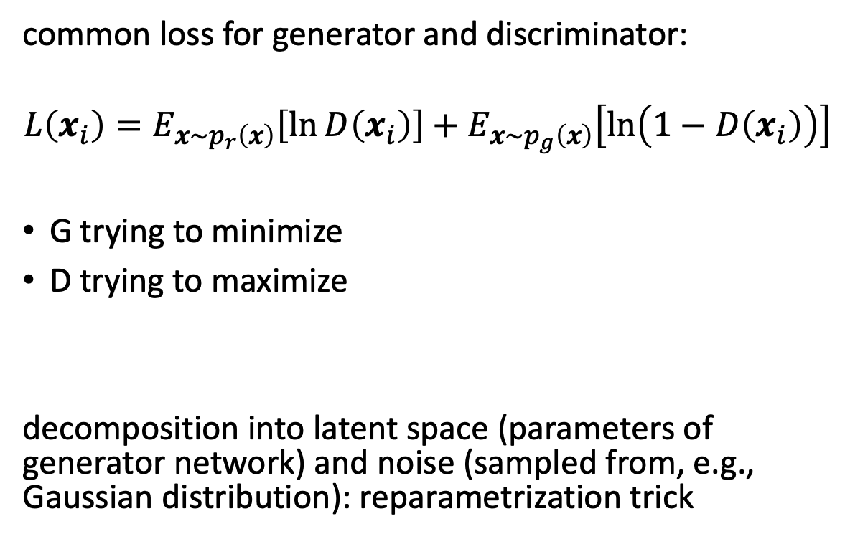
Formulation
common loss for generator and discriminator:
$$L\left(x_{i}\right)=E_{x\sim p_{r}\left(x\right)}\left[\ln{D\left(x_{i}\right)}\right]+E_{x\sim p_{g}\left(x\right)}\left[\ln\left(1−D\left(x_{i}\right)\right)\right]$$
G trying to minimize
D trying to maximize
decomposition into latent space (parameters of generator network) and noise (sampled from, e.g., Gaussian distribution): reparametrization trick
source

Slide 24
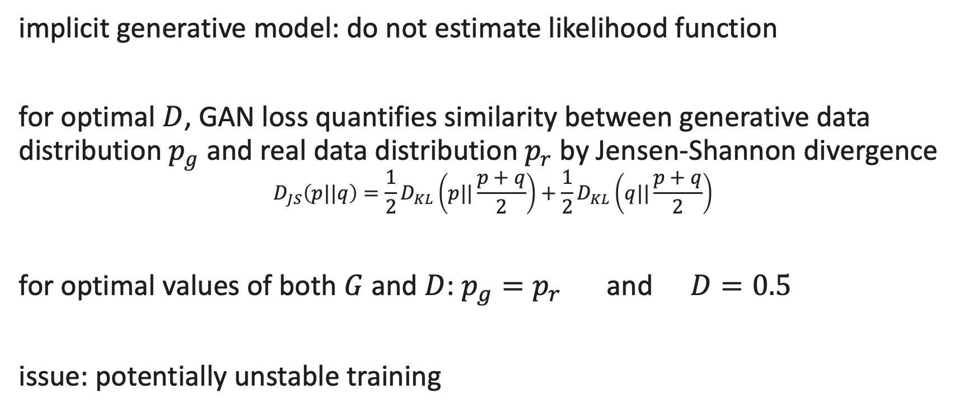
Properties
implicit generative model: do not estimate likelihood function
for optimal $D$, GAN loss quantifies similarity between generative data distribution $p_{g}$ and real data distribution $p_{r}$ by Jensen-Shannon divergence
$$D_{JS}\left(p||q\right)=\frac{1}{2}D_{KL}\left(p||\frac{p+q}{2}\right)+\frac{1}{2}D_{KL}\left(q||\frac{p+q}{2}\right)$$
for optimal values of both $G$ and $D$: $p_{g}=p_{r}$ and $D=0.5$
issue: potentially unstable training

Slide 25
Diffusion Models

Slide 26
Idea
training:
distort training data by successively adding random noise, then learn to reverse this process (denoising)
generation:
sample random noise and run through the learned denoising process
can be seen as special kind of energy-based models: parametrized energy function (to be minimized) of target, observable, and latent variables → no need for proper normalization of probability distributions

Slide 27
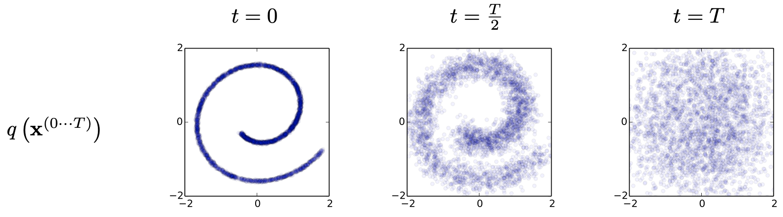
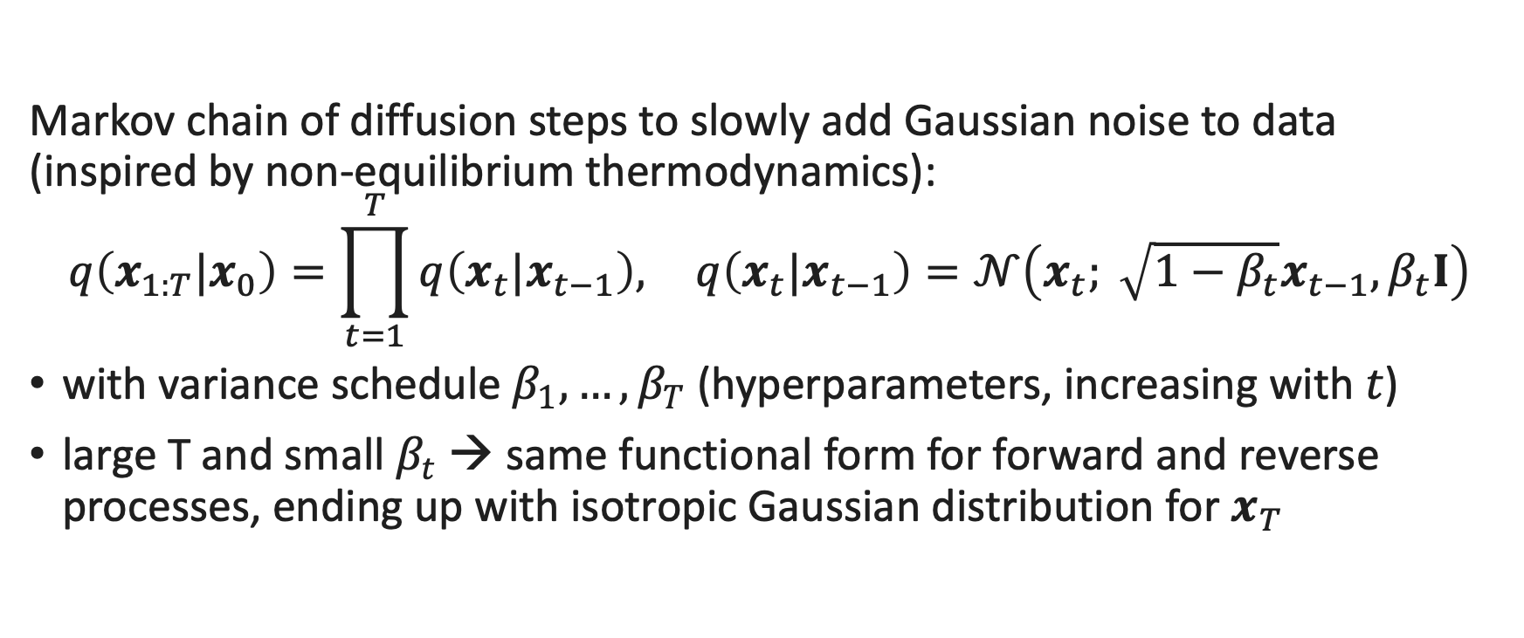
Forward Process
Markov chain of diffusion steps to slowly add Gaussian noise to data (inspired by non-equilibrium thermodynamics):
$$q\left(x_{1:T}|x_{0}\right)=\prod_{t=1}^{T}{q\left(x_{t}|x_{t−1}\right),} q\left(x_{t}|x_{t−1}\right)=𝒩\left(x_{t}; \sqrt{1−β_{t}}x_{t−1}, β_{t}I\right)$$
with variance schedule ${β_{1}, …, β}_{T}$ (hyperparameters, increasing with $t$)
large T and small $β_{t}$ → same functional form for forward and reverse processes, ending up with isotropic Gaussian distribution for $x_{T}$
source

Slide 28
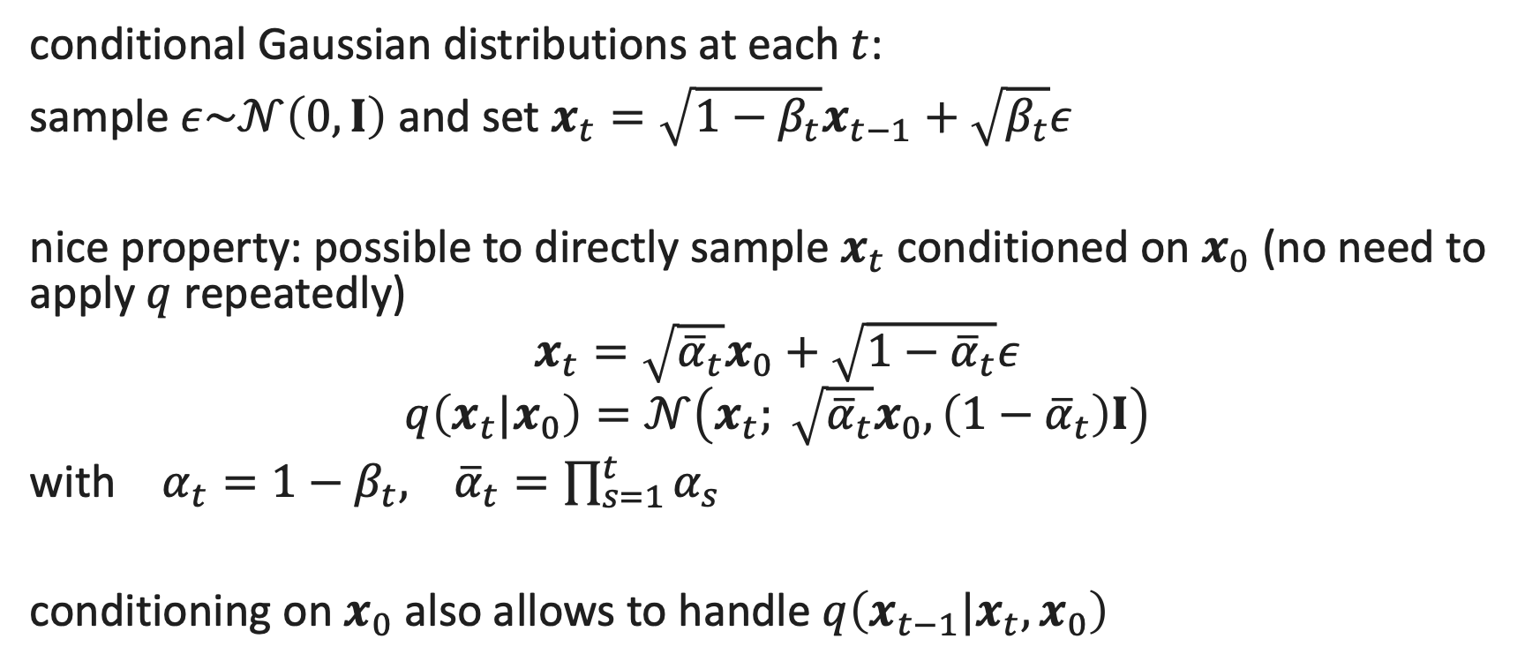
Reparametrization
conditional Gaussian distributions at each $t$:
sample $ε\sim 𝒩\left(0,I\right)$ and set $x_{t}=\sqrt{1−β_{t}}x_{t−1}+\sqrt{β_{t}}ε$
nice property: possible to directly sample $x_{t}$ conditioned on $x_{0}$ (no need to apply $q$ repeatedly)
$$x_{t}=\sqrt{{\overline{α}}_{t}}x_{0}+\sqrt{{1−\overline{α}}_{t}}ε$$
$$q\left(x_{t}|x_{0}\right)=𝒩\left(x_{t}; \sqrt{{\overline{α}}_{t}}x_{0},\left(1−{\overline{α}}_{t}\right)I\right)$$
with $α_{t}=1−β_{t}, {\overline{α}}_{t}=\prod_{s=1}^{t}{α_{s}}$
conditioning on $x_{0}$ also allows to handle $q\left(x_{t−1}|x_{t},x_{0}\right)$

Slide 29

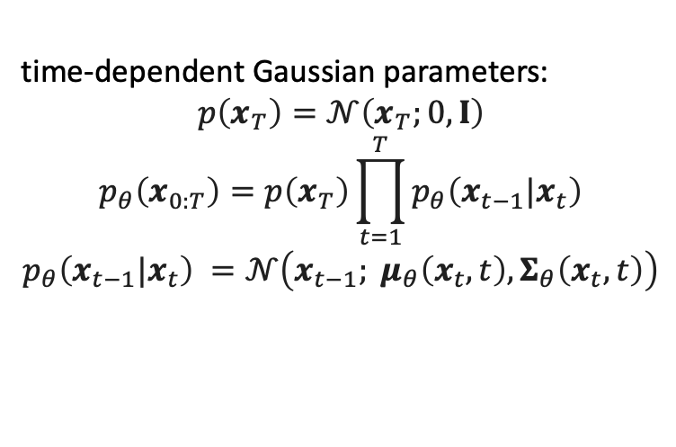

Reverse Process
to generate new data samples, one needs to learn to reverse the diffusion process (starting from pure noise): neural network learning to gradually denoise data
overall loss as sum of losses for each time step $t$
for each $t$: $D_{KL}$ between two Gaussians (closed form) $q\left(x_{t−1}|x_{t},x_{0}\right)$ and $p_{θ}\left(x_{t−1}|x_{t}\right)$
→ corresponds to VAE loss: maximizing ELBO
time-dependent Gaussian parameters:
$$p\left(x_{T}\right)=𝒩\left(x_{T};0,I\right)$$
$$p_{θ}\left(x_{0:T}\right)=p\left(x_{T}\right)\prod_{t=1}^{T}{p_{θ}\left(x_{t−1}|x_{t}\right)}$$
$$p_{θ}\left(x_{t−1}|x_{t}\right) =𝒩\left(x_{t−1}; μ_{θ}\left(x_{t},t\right),Σ_{θ}\left(x_{t},t\right)\right)$$
source

Slide 30
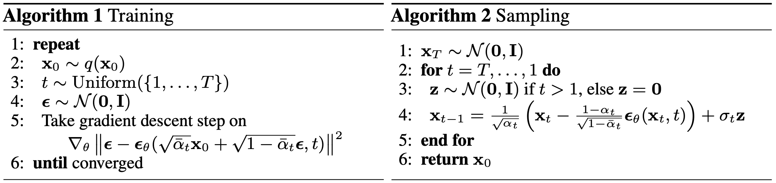

Noise Prediction
reparametrization allows to learn added noise instead of Gaussian parameters:
L2-loss (MSE) between true and predicted Gaussian noise at time step $t$
use position embeddings (as network parameters are shared across time)
diffusion models can be interpreted as chain of denoising autoencoders (also connected to score-based generative modeling via Langevin dynamics)
source

Slide 31

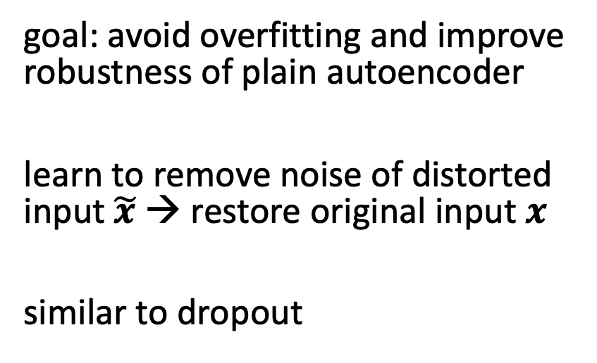
Denoising Autoencoder
goal: avoid overfitting and improve robustness of plain autoencoder
learn to remove noise of distorted input $\tilde{x}$ → restore original input $x$
similar to dropout
source
differences of diffusion models to typical denoising autoencoders:
no bottleneck (care about output here, not internal representation): latent space with high dimensionality (same as original data)
handle many different noise levels with single set of shared parameters

Slide 32
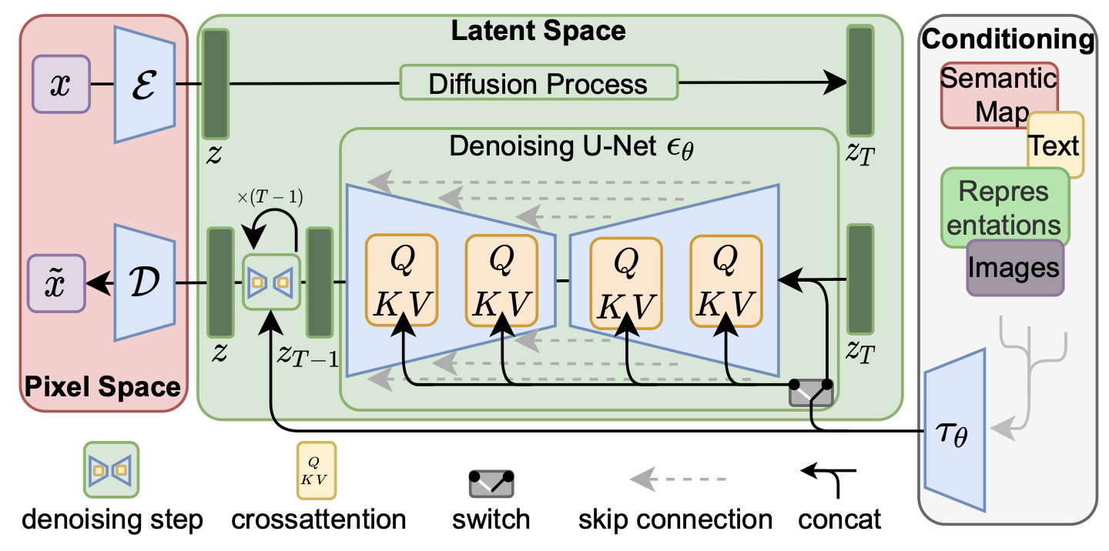
Latent Diffusion Model
add noise to latent representation rather than raw data
→ significant speedup
diffusion model highly flexible in terms of architecture: only require same input and output dimensionality → often U-Net-like architectures (autoencoder-like) with skip connections (and attention to handle flexible conditioning)
source

Slide 33
Conditioned Generation

Slide 34

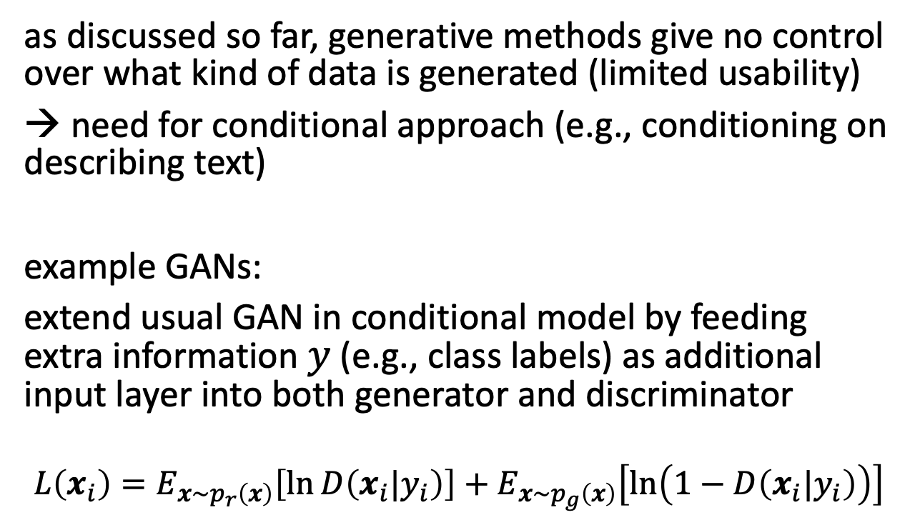
Conditional GANs
as discussed so far, generative methods give no control over what kind of data is generated (limited usability)
→ need for conditional approach (e.g., conditioning on describing text)
example GANs:
extend usual GAN in conditional model by feeding extra information $y$ (e.g., class labels) as additional input layer into both generator and discriminator
$$L\left(x_{i}\right)=E_{x\sim p_{r}\left(x\right)}\left[\ln{D\left(x_{i}|y_{i}\right)}\right]+E_{x\sim p_{g}\left(x\right)}\left[\ln\left(1−D\left(x_{i}|y_{i}\right)\right)\right]$$
source

Slide 35

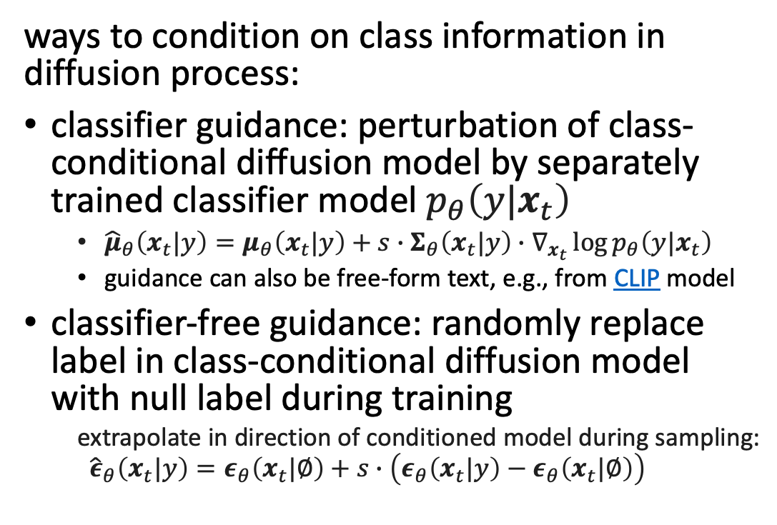
Guided Diffusion
ways to condition on class information in diffusion process:
classifier guidance: perturbation of class-conditional diffusion model by separately trained classifier model $p_{θ}\left(y|x_{t}\right)$
${\hat{μ}}_{θ}\left(x_{t}|y\right)=μ_{θ}\left(x_{t}|y\right)+s∙Σ_{θ}\left(x_{t}|y\right)∙∇_{x_{t}}\log{p_{θ}\left(y|x_{t}\right)}$
guidance can also be free-form text, e.g., from CLIP model
classifier-free guidance: randomly replace label in class-conditional diffusion model with null label during training
extrapolate in direction of conditioned model during sampling:
$${\hat{ε}}_{θ}\left(x_{t}|y\right)=ε_{θ}\left(x_{t}|∅\right)+s∙\left(ε_{θ}\left(x_{t}|y\right)−ε_{θ}\left(x_{t}|∅\right)\right)$$
tradeoff between diversity (unconditioned) and fidelity (guidance)
“Pembroke Welsh corgi”
guidance scale: hyperparameter for tradeoff between sample quality and diversity
source

Slide 36

Applications
plenty of implementations available
text-to-image: DALL-E 2, Stable Diffusion, GLIDE, ImageGen, ...
also text-to-speech (e.g., VALL-E), text-to-video (e.g., Make-A-Video), ...
web app for Stable Diffusion: DreamStudio

Slide 37

Inpainting
GLIDE example:
source

Slide 38
Literature
papers:
variational autoencoder
normalizing flows
GAN
denoising diffusion, latent diffusion

Slide 39


Movie-like Intelligence
emergent capabilities of complex systems almost impossible to foresee
mini examples in contemporary ML:
large language models
multi-agent reinforcement learning
one idea: reward is enough
philosophical: emotions or consciousness might also occur as emergent capabilities

